Slide 1
News Image Classification
CS 640 Project 2 Topic 2
By: Maya Shen, Rongyu Wang, Xiankang Wu

Slide 2
Problem Definition
Nowadays journalists are not the first ones to record an emergency event but any civilians with phones, and they send to social media almost immediately when such event takes place in their proximity.
For this project, we build a system that looks for such event in a pool of images originated from social media feeds; the system consists of two parts:
Deep Neural Network trained for object detection
Expert System that yields an emergency level score based on the object(s) detected from images.

Slide 3
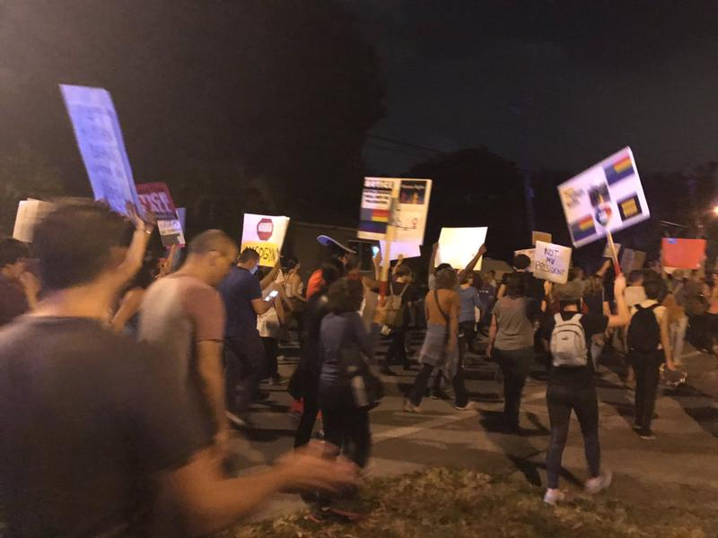
Background
Understanding issues such protest and violence has been a critical topic within research field crossing different academic disciplines.
facial attribute classification
Photograph & Portrait Analysis
Social media presence examination
And so on …

Slide 4
Baseline Approaches
Original Paper and Method Reproduction
Transfer Learning on Single Class Classification
Fine Tuning
Fixed Feature Extractor
Transfer Learning on Multi-label Detection

Slide 5
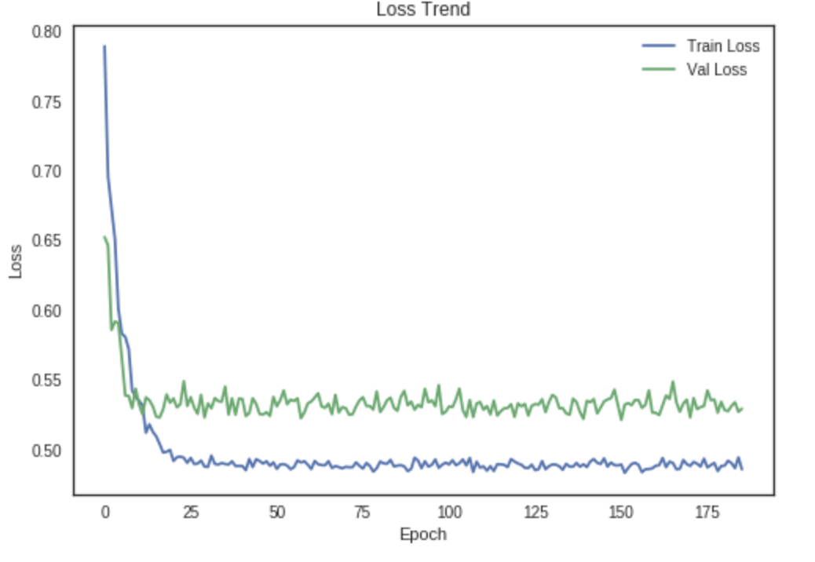
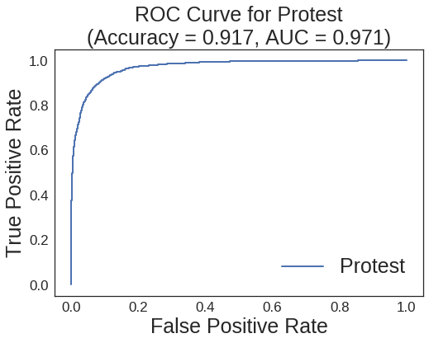
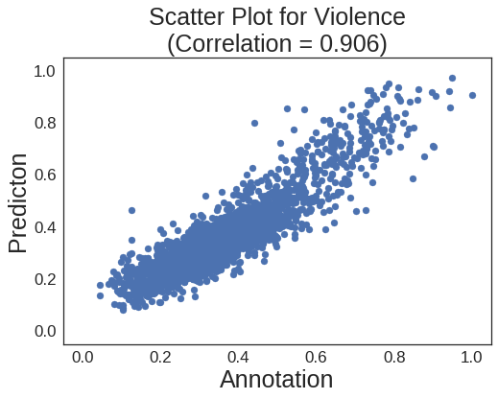
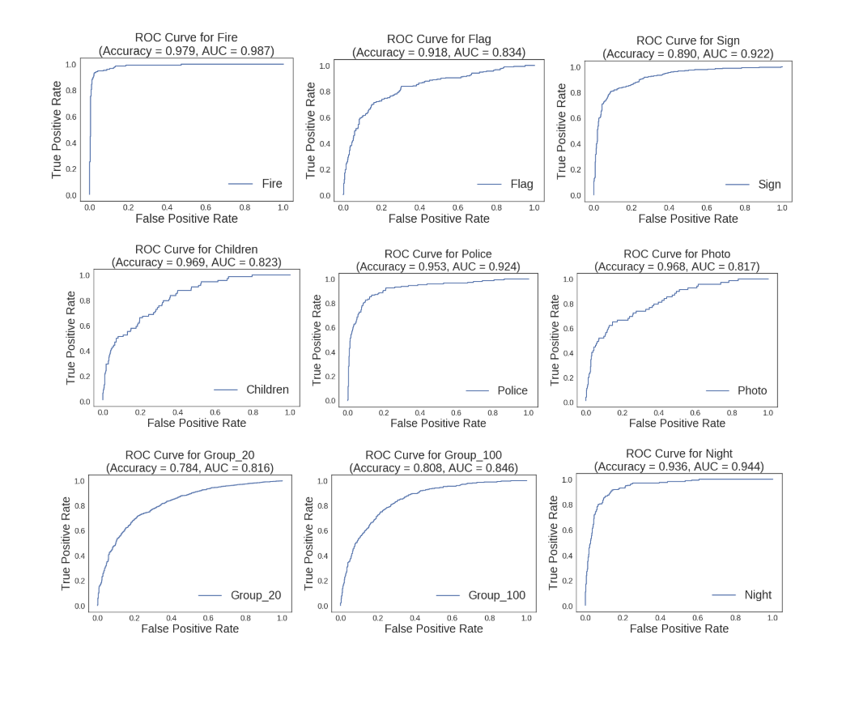
Original Paper Reproduction
Loss Trend keeps fluctuating after epoch = 50
Average Accuracy/AUC/Correlation gets 85% and above.

Slide 6
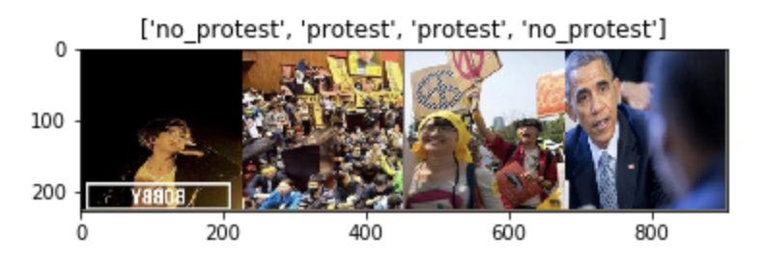
Transfer Learning on Single Class (Protest)
Fine Tuning (25 Epochs, best validation Acc: 0.8688)
Fixed Feature Extractor (best validation Acc: 0.8375)

Slide 7
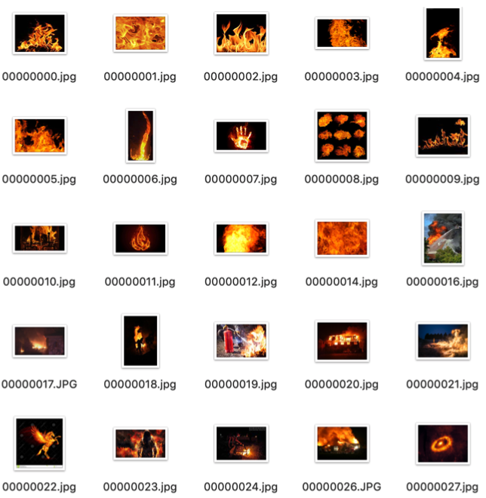
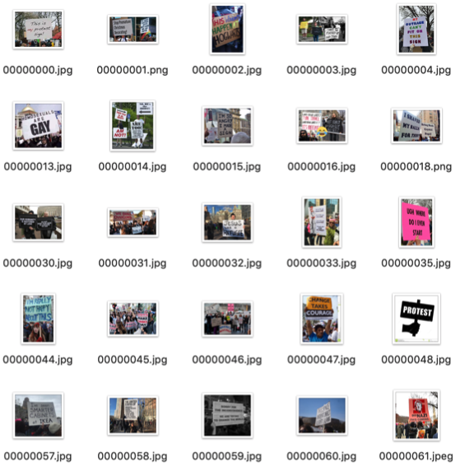
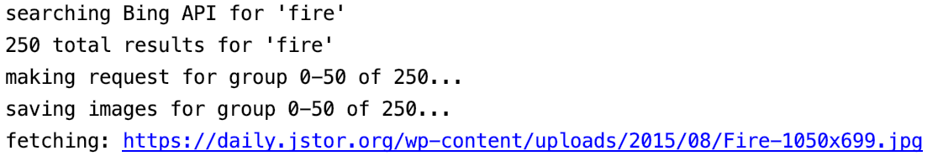
Transfer Learning on Multi-label objects
Initial idea: avoid using bounding boxes.
To train our own classifier, first we need to find good resource of datasets.
Bing Image Search API is a RESTful service, ideal for fetching images we desired with simple HTTP request

Slide 8
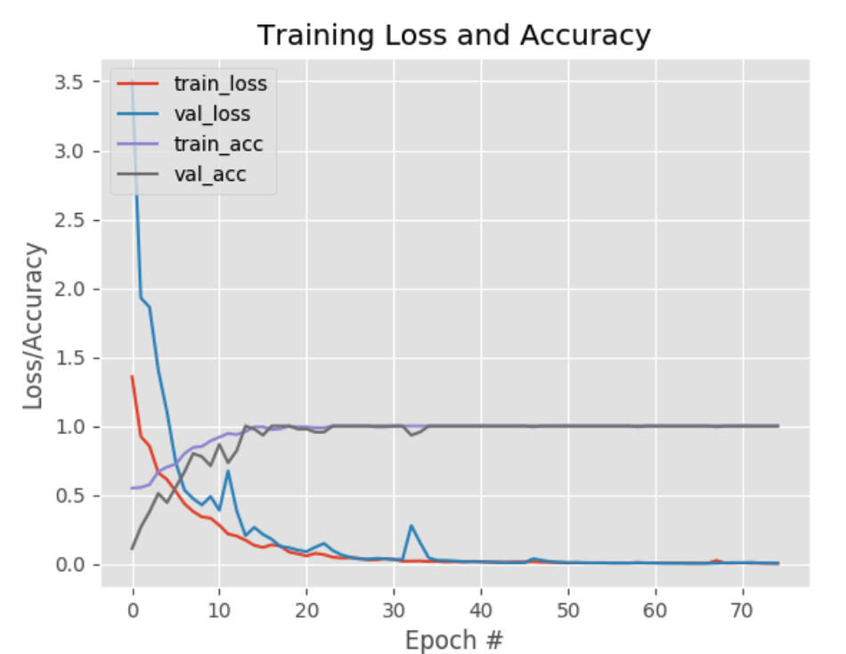
Transfer Learning on Multi-label objects
With Epoch = 75, Our model performs well for a single object detection.
Not ideal for multi-label objects detection when several objects are presented.
Bounding box data is still required for training complicated classifier.

Slide 9
Improvement
Before Training: Dataset Quality
During Training: Parameter Tuning
After Training: Extra Functionalities
Simple Expert System
Crowd Detection

Slide 10
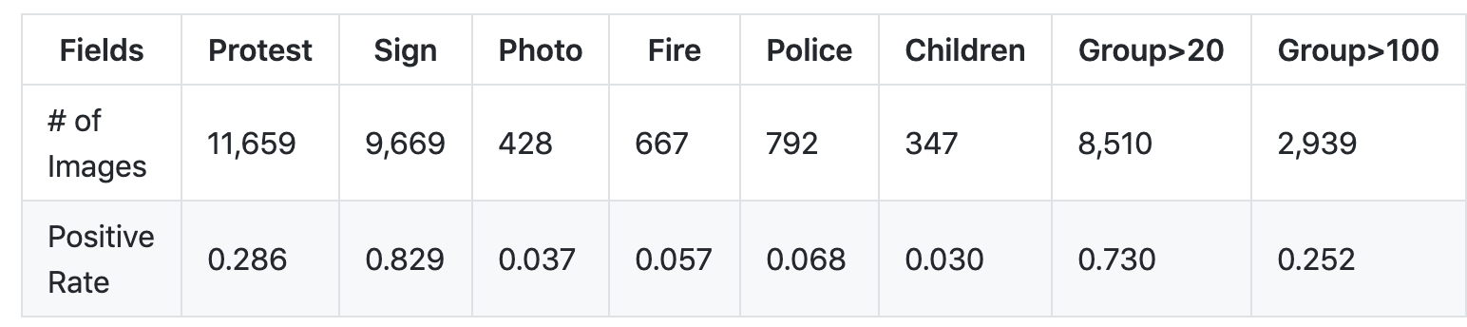
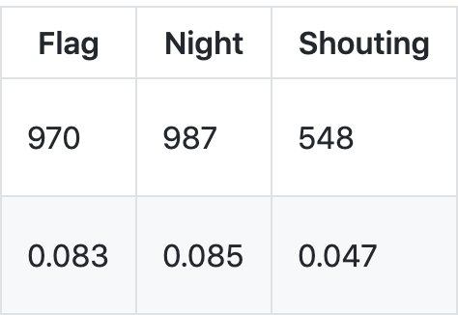
Dataset: UCLA_PROTEST_IMAGE_DATASET
# of images: 40,764
# of protest images: 11,659
Training set/ Test set = 8:2

Slide 11
Speed and Learning Rate Tuning
Speed: running time comparison for 25 Epochs, CUP took 42m11s to complete while GPU took 53s.
Learning Rate: fine-tuned models should adapt relatively small LR as the network weights are at a good level to start with, a large LR will distort the model too quickly and too much. LR originally sets at 0.001, and was tuned towards smaller end, but results are less than desirable in terms of training speed and cost function.

Slide 12
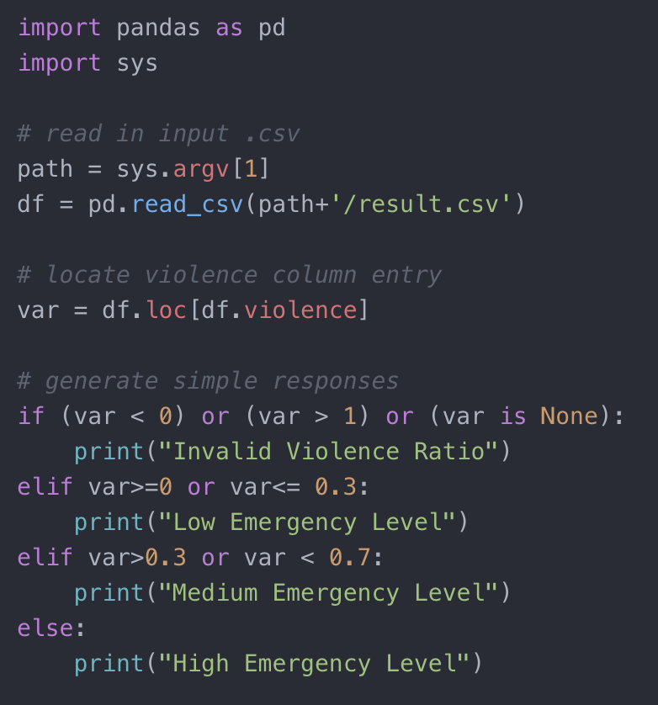
Simple Expert System
A very simple ‘expert system’ was build to illustrate our idea of generating an Emergency Level Rating after an image’s passed through the Neural Network.
Potential Improvements:
Involving more input measures, now we’re only looking at violence, could include measures for presence of fire, children
More detailed categorization for emergency level

Slide 13
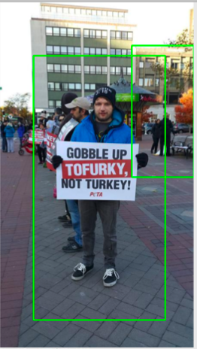
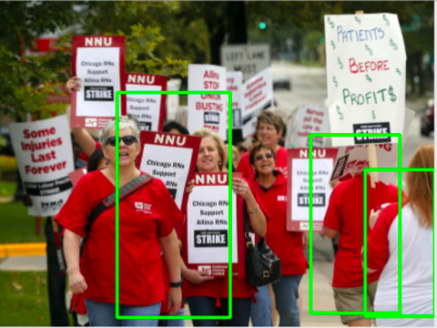
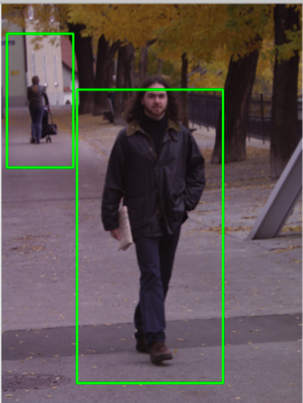
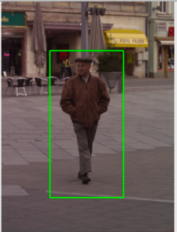
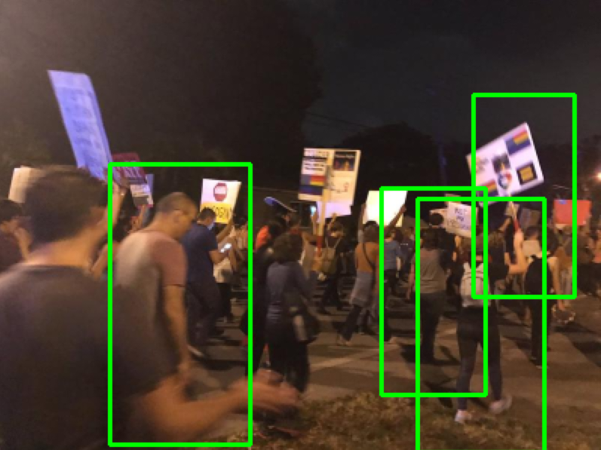
Crowd Detection
Potential interest points: crowd count during a protest.
Explored and used OpenCV built-in HOG descriptor and SVM detector.
Draw bounding boxes around people detected and counting them.
Applied Non-maxima suppression to suppress overlapping bounding boxes to achieve the correct final detection.
Not ideal for dense, overlaid crowd scene.
Great for Pedestrians when people are fully included.

Slide 14
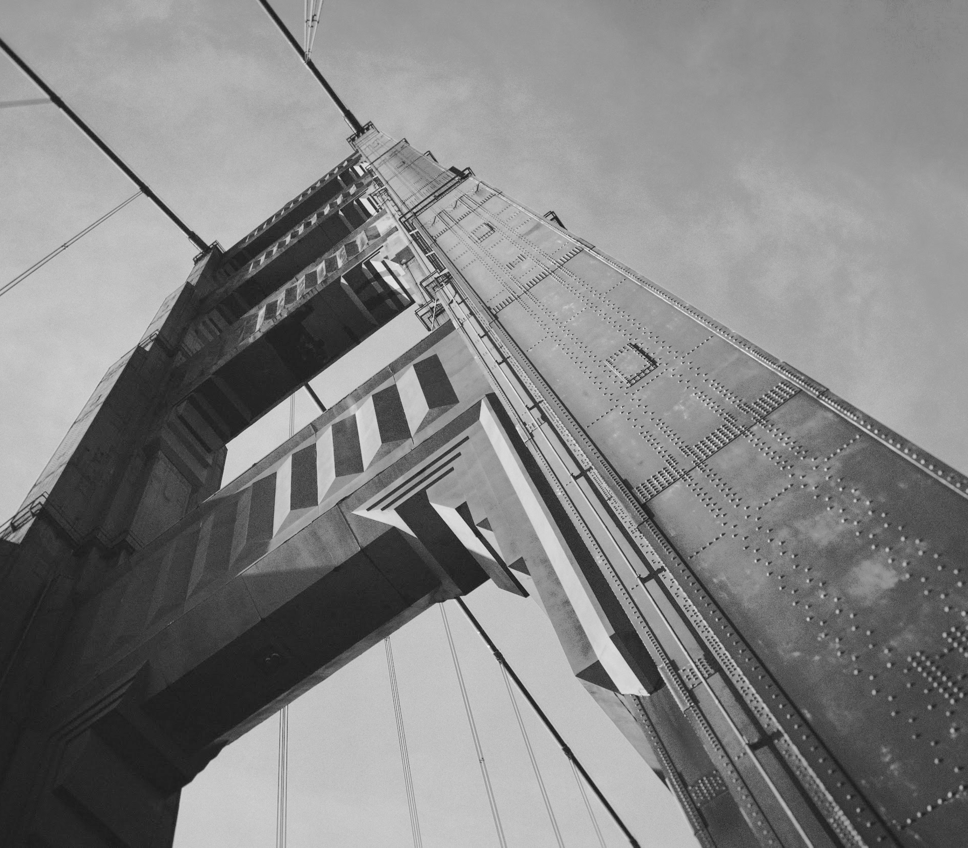
Thanks!

